Slide 1
An Evaluation of the 1980 Version of Thai-based Writing System Used in Chob Khacha-Anant’s Yao (Iu-Mien) Lessons in View of Language Maintenance for their Communities
The 11th International Conference on Thai Studies, 26-28 July 2011
Chiangrai Rajabhat University, Thailand
T. Daniel Arisawa

Slide 2
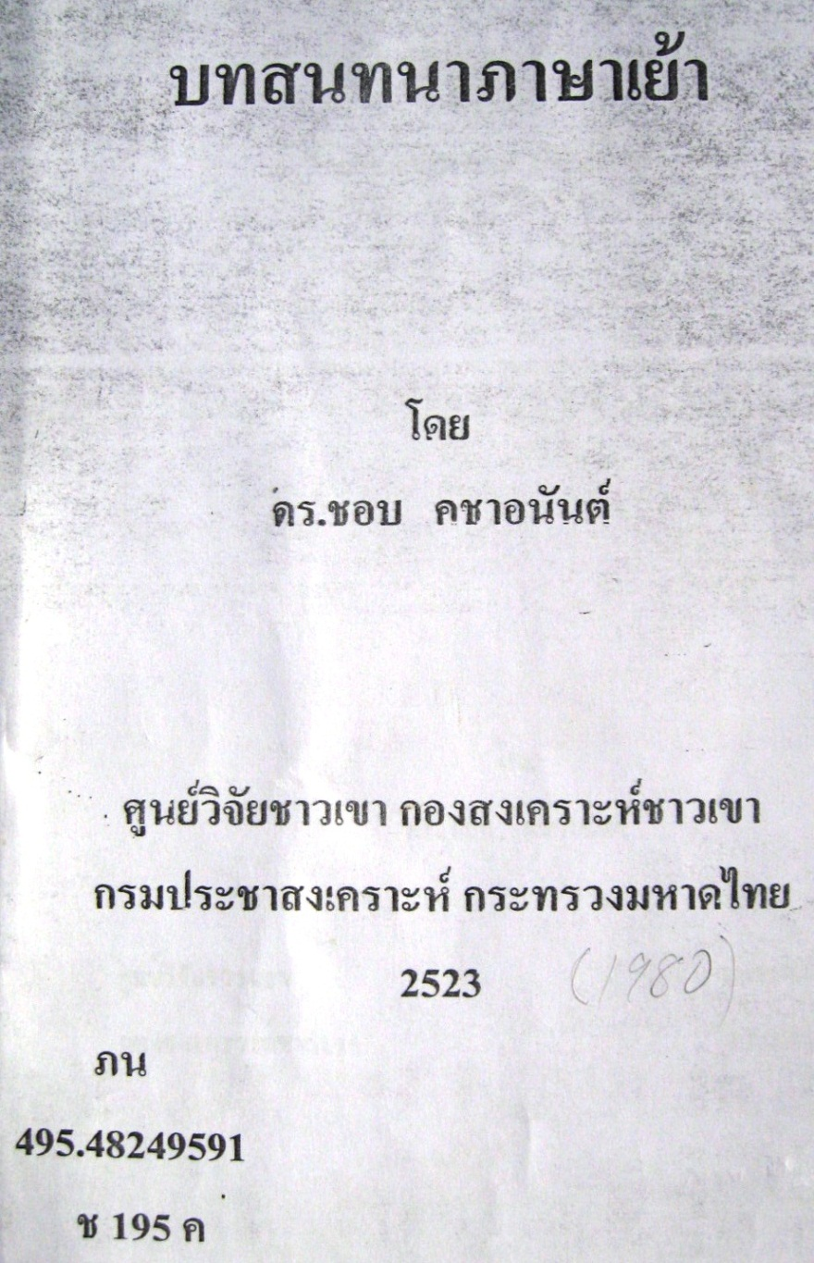
Conversation Lessons in Yao
Intro>Consonants>Vowels>Tones>Compare>Discussion>Conclusion
Yao = Iu-Mien
Dr. Chob Khacha’anant
Former researcher at the Tribal Research Institute, Chiangmai University.
The Tribal Welfare Division, the Public Welfare Department

Slide 3

Conversation Lessons in Yao
Intro>Consonants>Vowels>Tones>Compare>Discussion>Conclusion
Goals of the book
To equip the Thai officers of the Tribal Welfare Division with the means of communication in the tribal languages to carry out their duties
Thus to reach the hearts of the tribal peoples.

Slide 4
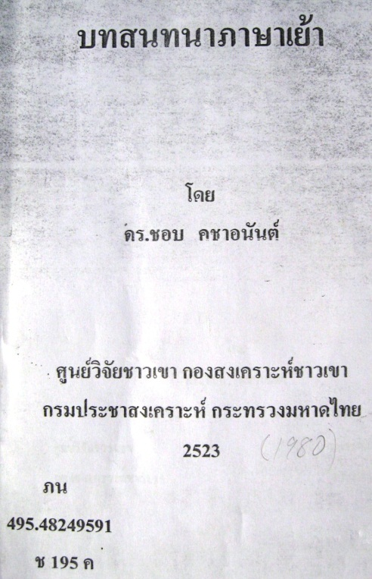
Conversation Lessons in Yao
Intro>Consonants>Vowels>Tones>Compare>Discussion>Conclusion
Nature of the book includes…
The use of the Thai script to express the hill tribes’ languages,
That grammatical description is not intended to be the professional linguistics level and that revisions should be necessary in the future,
The goal of the development of welfare for tribal peoples.

Slide 5

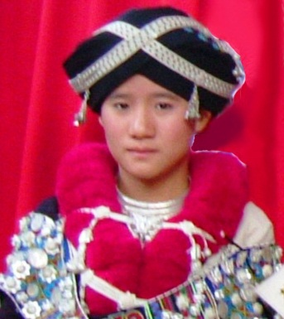
Intro>Consonants>Vowels>Tones>Compare>Discussion>Conclusion
Hmong-Mien
Hmongic
Mienic
Pa-Hng
Jiongnai/Ho Ne
Biao Min
Zao Min
Mienic-Mun
Mien
Mun
West Hmong
Hmong
A-Hmao
Bunu
West Hmong
Qo Xiong
West Hmong
Hmu
Ratliff 2011

Slide 6
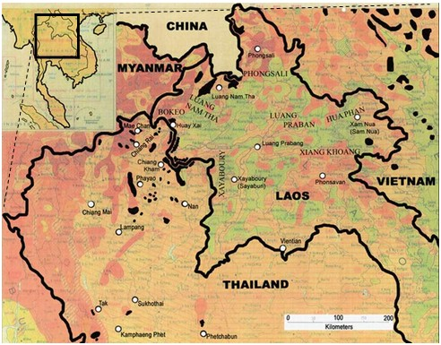
Conversation Lessons in Yao
Intro>Consonants>Vowels>Tones>Compare>Discussion>Conclusion

Slide 7
Purposes of the paper
Intro>Consonants>Vowels>Tones>Compare>Discussion>Conclusion
To understand Cob’s system of writing Iu-Mien
To lay a foundation for an indeapth comparative study between Chob’s writing system (1980) and the 1956 version of Iu-Mien orthography.
To find out its usefulness in terms of (1) its transfer value to the National Language and (2) its possibility toward language maintenance.
Henceforth, “the 1980 Version” (Chob) and “the 1956 Version”.

Slide 8
Two fundamental questions
Intro>Consonants>Vowels>Tones>Compare>Discussion>Conclusion
1 Does the orthography help Iu-Mien children to read and write Standard Thai?
2 If an adult Mien who is already literate in Thai picks up an Iu-Mien book written in this orthography, how easy is it for him/her to read and understand it using Thai rules?

Slide 9
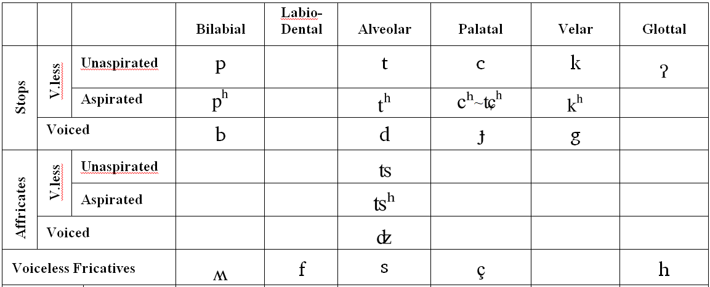
Iu-Mien phonology: Consonants
Intro>Consonants>Vowels>Tones>Compare>Discussion>Conclusion

Slide 10
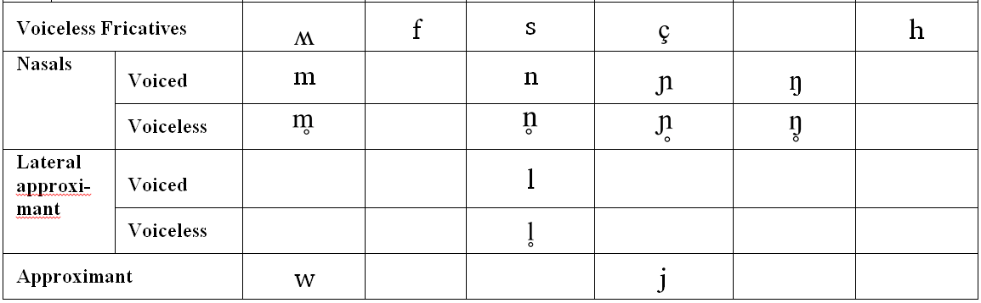
Iu-Mien phonology: Consonants
Intro>Consonants>Vowels>Tones>Compare>Discussion>Conclusion
33 initial consonants
20 consonants are shared with Standard Thai
13 are unique to Iu-Mien (non-existent in Thai)
Challenge!

Slide 11
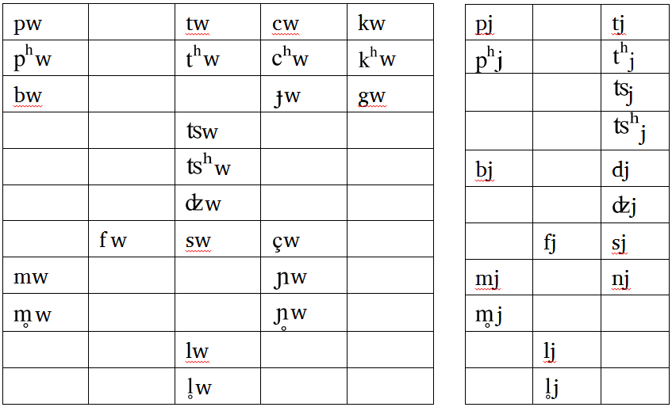
Consonant clusters
Intro>Consonants>Vowels>Tones>Compare>Discussion>Conclusion

Slide 12
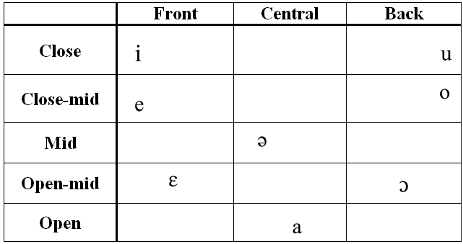
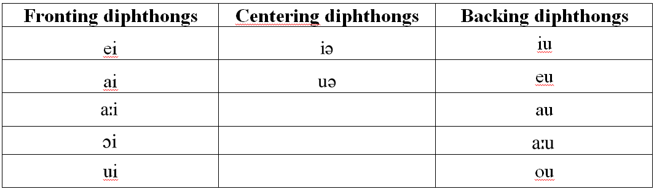
Iu-Mien phonology: Vowels
Intro>Consonants>Vowels>Tones>Compare>Discussion>Conclusion
8 monophthongs
12 diphthongs

Slide 13
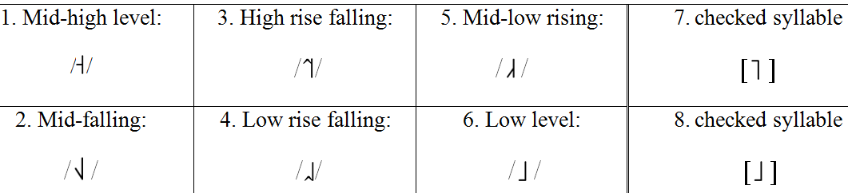
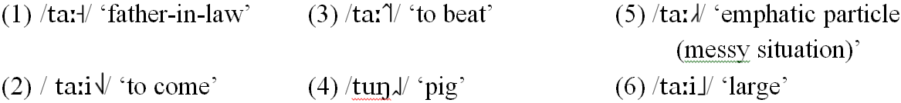
Iu-Mien phonology: Tones
Intro>Consonants>Vowels>Tones>Compare>Discussion>Conclusion
6 phonemic tones
2 allotones
Challenge!

Slide 14
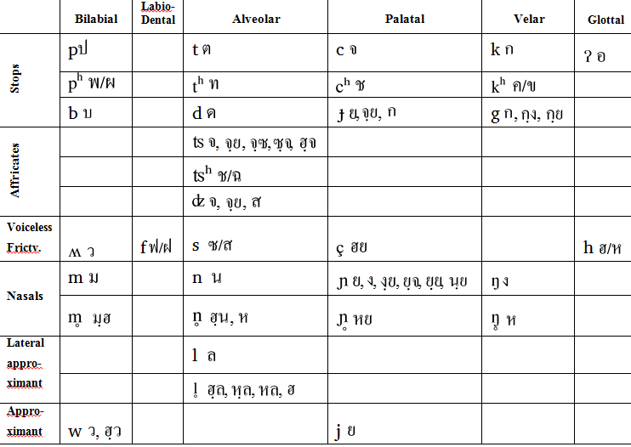
Expressing consonants in the 1980 version
Intro>Consonants>Vowels>Tones>Compare>Discussion>Conclusion
High class and low class are used

Slide 15
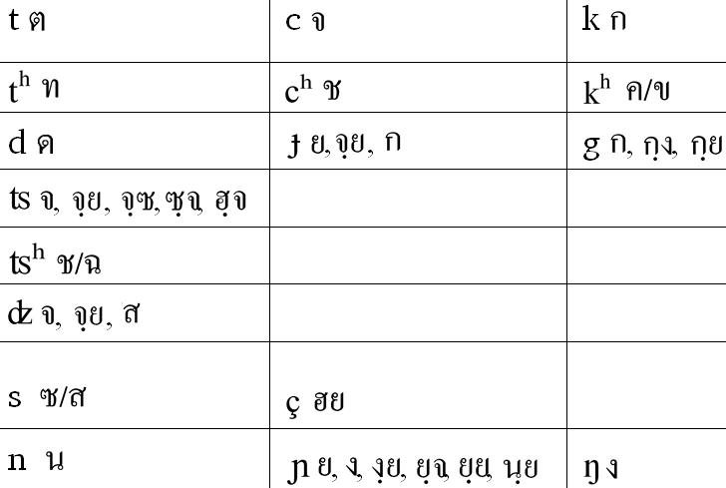
Intro>Consonants>Vowels>Tones>Compare>Discussion>Conclusion
Expressing consonants in the 1980 version
Multiple letters for one phoneme

Slide 16
Intro>Consonants>Vowels>Tones>Compare>Discussion>Conclusion
Expressing consonants in the 1980 version
One letter for multiple phonemes

Slide 17
Intro>Consonants>Vowels>Tones>Compare>Discussion>Conclusion
Expressing consonants in the 1980 version
One letter for multiple phonemes

Slide 18
Intro>Consonants>Vowels>Tones>Compare>Discussion>Conclusion
Expressing consonants in the 1980 version
One letter for multiple phonemes

Slide 19
Intro>Consonants>Vowels>Tones>Compare>Discussion>Conclusion
Expressing consonants in the 1980 version
One letter for multiple phonemes

Slide 20
Intro>Consonants>Vowels>Tones>Compare>Discussion>Conclusion
Expressing consonants in the 1980 version
Is the order of letters phonemic?
?

Slide 21
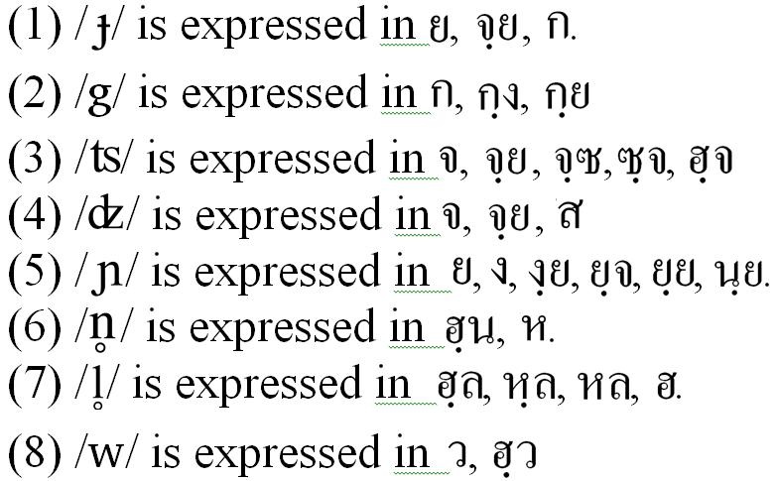
Intro>Consonants>Vowels>Tones>Compare>Discussion>Conclusion
Expressing consonants in the 1980 version
Some examples

Slide 22
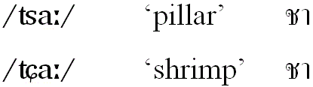
Intro>Consonants>Vowels>Tones>Compare>Discussion>Conclusion
Expressing consonants in the 1980 version
Complete loss of / /
and replaced with
̷

Slide 23
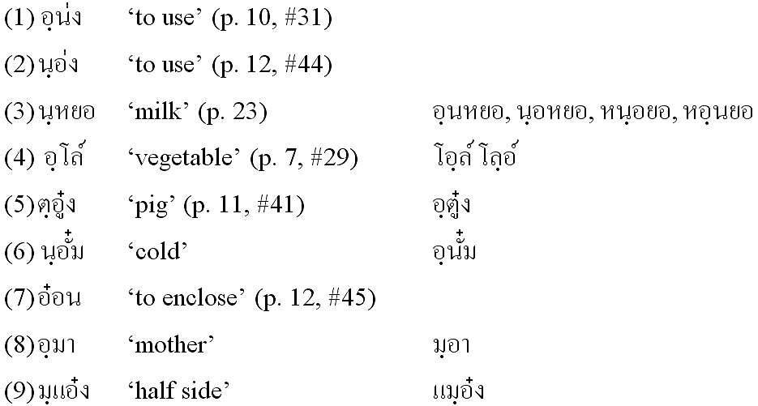
Intro>Consonants>Vowels>Tones>Compare>Discussion>Conclusion
Expressing consonants in the 1980 version
Preglottalized Consonants Expressed by the use of bigraphemes
Some older Iu-Mien are concerned about the recent loss of preglottalized consonants: The like these.
แอฺมอ๋ง แมฺออ๋ง แอฺหมอง

Slide 24
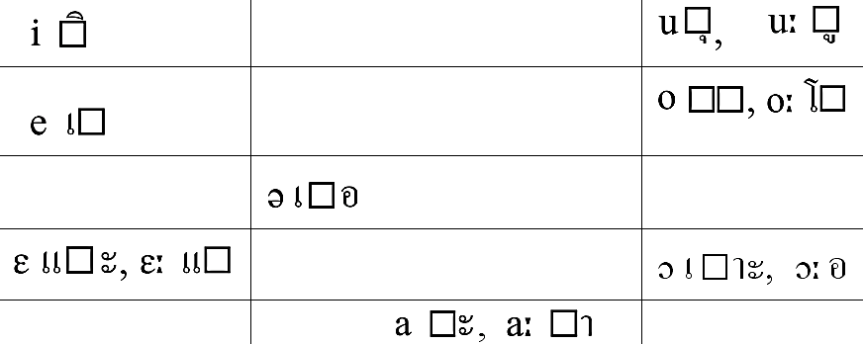
Vowels in the 1980 Version
Intro>Consonants>Vowels>Tones>Compare>Discussion>Conclusion
All monophthongs are nicely represented by Thai writing convention.

Slide 25
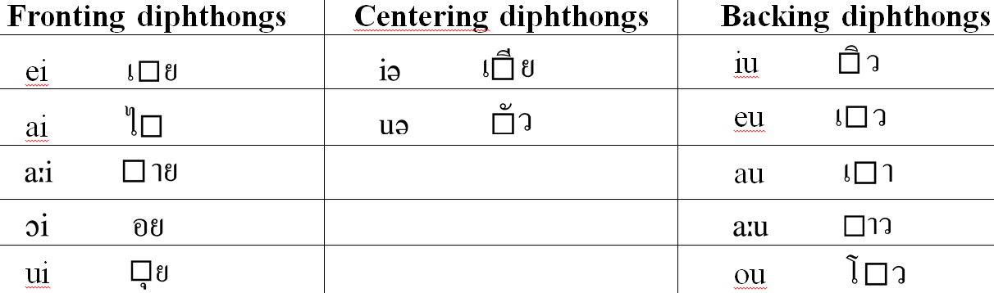
Vowels in the 1980 Version
Intro>Consonants>Vowels>Tones>Compare>Discussion>Conclusion
Only one diphthong /ou/ is problematic.
Irregular choice between โ and โ-ว, (of which the latter is correct representation).

Slide 26
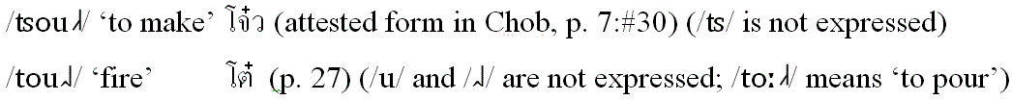


Vowels in the 1980 Version
Intro>Consonants>Vowels>Tones>Compare>Discussion>Conclusion
The correct sound of / / is replaced with [ ]
are not
expressed)

Slide 27

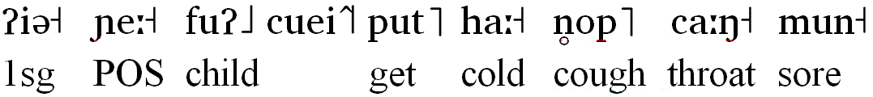
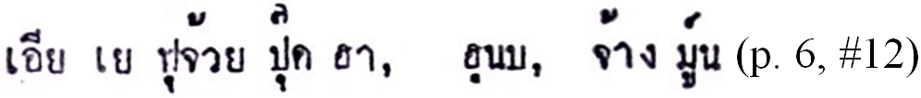
Tones in the 1980 Version
Intro>Consonants>Vowels>Tones>Compare>Discussion>Conclusion
1. Problem of Tone 1: (mid-high level tone / /)
flu
“My child got flu; (he) coughing and has a sore throat.”

Slide 28

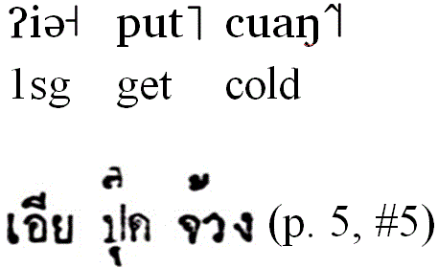
Tones in the 1980 Version
Intro>Consonants>Vowels>Tones>Compare>Discussion>Conclusion
2. Problem of Tone 3 (high rise falling tone / /)
“I’ve got a cold.”
จ๊วง
Merger of Tone 3 (high rise falling) with Tone 2 (mid-falling) in many examples.

Slide 29
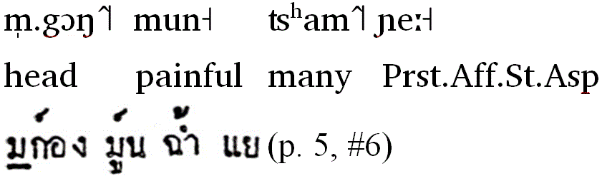
Tones in the 1980 Version
Intro>Consonants>Vowels>Tones>Compare>Discussion>Conclusion
2. Problem of Tone 3 (high rise falling tone / /)
“I’ve got a severe headache.”
ฉ๊ำ/ช้ำ
มก๊อง
Merger of Tone 3 to Tone 1 and Tone 2. = Loss of Tone 3.

Slide 30

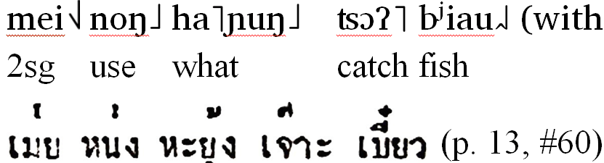
Tones in the 1980 Version
Intro>Consonants>Vowels>Tones>Compare>Discussion>Conclusion
3. Loss of Tone 4 (low rise falling / /)
With a question/ rising intonation
“How do you catch fish?”
Merger of Tone 4 to Tone 5 (mid-low rising) = Loss of Tone 4.

Slide 31
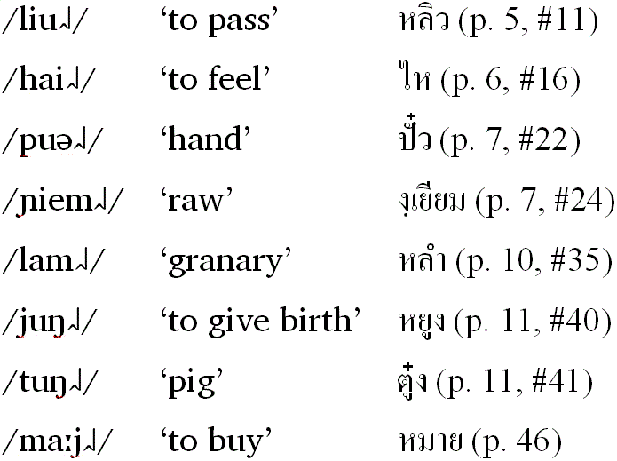
Tones in the 1980 Version
Intro>Consonants>Vowels>Tones>Compare>Discussion>Conclusion
  3. Loss of Tone 4 (low rise falling / /) (cont.)

Slide 32

The 1980 Version: Conversation
Intro>Consonants>Vowels>Tones>Compare>Discussion>Conclusion
4. Tone Sandhi
Hurbert Purnell (2002:304-5) “Tone change [i.e. sandhi] occurs on the first member of a compound expression and is phonetically regular: syllables with stop finals become the c tone [i.e. low level / /], and all non-stopped syllables become the h tone [i.e. mid-falling / /]”

Slide 33
The 1980 Version: Conversation
Intro>Consonants>Vowels>Tones>Compare>Discussion>Conclusion
4. Tone Sandhi

Slide 34
What implication does this have toward language maintenance?
Intro>Consonants>Vowels>Tones>Compare>Discussion>Conclusion
1. Does this writing system help Iu-Mien children to read and write Standard Thai? (Out-going transfer value)
Yes, actually by teaching this system, you are teaching Thai.

Slide 35
What implication does this have toward language maintenance?
Intro>Consonants>Vowels>Tones>Compare>Discussion>Conclusion
One can learn it.
But he/she looses 20% of consonant phoneme, 30% of tone.
He/she has to cope with irregular spellings, will loose many words.
However, recording of preglottalization is beneficial for maintenance.
2. If an adult Mien who is already literate in Thai picks up an Iu-Mien book written in this writing system, how easy is it for him/her to read and understand it using Thai rules? (In-coming transfer value)

Slide 36
Summary
Intro>Consonants>Vowels>Tones>Compare>Discussion>Conclusion
1. Chob’s system is, first and for most, for Thai native speakers to learn the very basic conversational vocabulary.
2. Device for this purpose is the phonetically oriented use of Thai scripts which are highly phonologically restricted inventories within the Standard Thai orthographic convention.

Slide 37
Summary
Intro>Consonants>Vowels>Tones>Compare>Discussion>Conclusion
3. To maximize the phonetic descriptive capacity, Chob’s system utilizes bigraphemes with a dot underneath the first grapheme.
4. As a result of #3, the device well records the preglottalized initial consonants and the unique mid-high level tone.

Slide 38
Summary
Intro>Consonants>Vowels>Tones>Compare>Discussion>Conclusion
5. However, working from the grids of Thai phonology, some distinctive Iu-Mien phonemes are merged with each other and the low rise falling tone is categorically unrecognized, thus lost.
6. The merger of phonemes results in inconsistency of the letter use and inaccuracy in expressing many Iu-Mien words.

Slide 39
Summary
Intro>Consonants>Vowels>Tones>Compare>Discussion>Conclusion
7. This is a descriptive tool at the level of pre-phonological analysis, which the author is aware of in view of the future revision.
This writing system is primarily from the outsider’s perspective to facilitate the initial contact with the Iu-Mien; but not for the insiders’ practical use. The Iu-Mien, if they learn it, they would see a different type of Iu-Mien.

Slide 40
Conclusion
Intro>Consonants>Vowels>Tones>Compare>Discussion>Conclusion
With this book in hand, 30 years ago, the border police men, health workers, and young teachers like Kru Baan Nork went deep into the mountains, and helped many Iu-Mien who were illiterate in Thai to understand that the Thai government wanted to reach their hearts. (Some married the Iu-Mien.)

Slide 41
Conclusion (cont.)
Intro>Consonants>Vowels>Tones>Compare>Discussion>Conclusion
As a result, almost all Iu-Mien in Chiangrai, Phayao, Chiangmai, Sukhothai, Kapaengphet, have Thai ID card. (Some are waiting in Naan.)

Slide 42
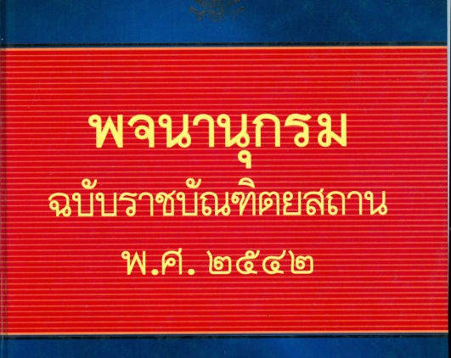
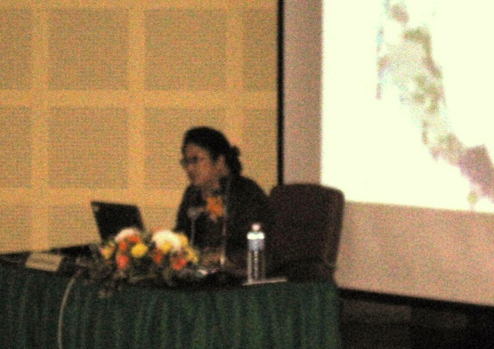
Conclusion (cont.)
Intro>Consonants>Vowels>Tones>Compare>Discussion>Conclusion
Today, Thai Royal Institute, commissioned by the former Prime Minister, is working hard to make a new National Language Policy, one of whose six policies is the preservation and revitalization of endangered languages.

Slide 43
Conclusion (cont.)
Intro>Consonants>Vowels>Tones>Compare>Discussion>Conclusion
Now, it is urgently important for the Iu-Mien community to find out which orthography best serves to document their oral literature, cultural knowledge, and local wisdom, from the available choices devised in the past 80 years.
(The Roman-based Iu-Mien orthography is officially recognized by the Chinese government and taught in some district schools in the USA.)

Slide 44
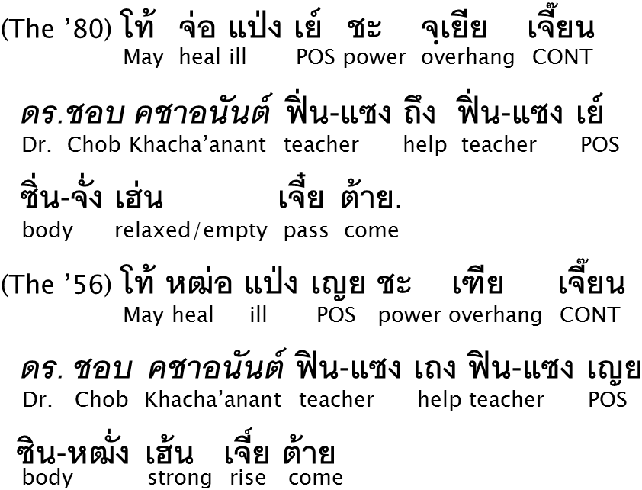
Acknowledgement
Intro>Consonants>Vowels>Tones>Compare>Discussion>Conclusion
May the recuperative power will be ensured for Dr. Chob Khacha’anant and strengthen your body.

Slide 45
Acknowledgement
Intro>Consonants>Vowels>Tones>Compare>Discussion>Conclusion

Slide 46
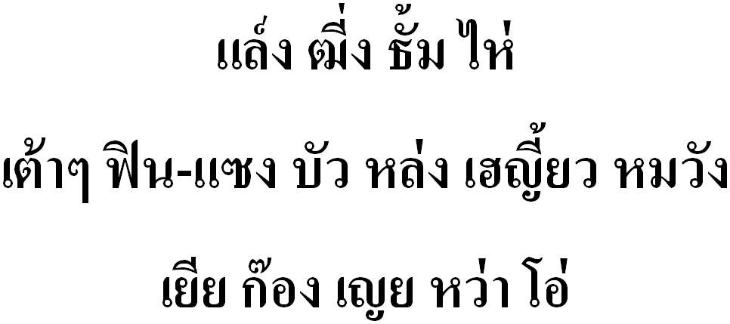
Thank you very much.
In the 1956 Version

