Slide 1
Nong Nae Revisited: Continuity and Change in a Post-frontier Community
Philip Hirsch
Professor of Human Geography
School of Geosciences
University of Sydney

Slide 2
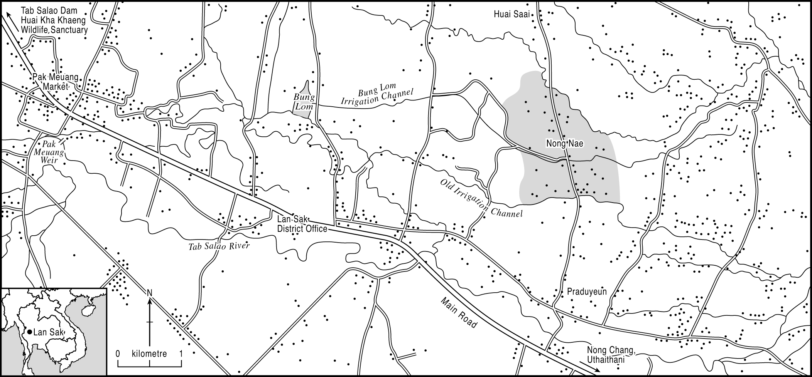
Nong Nae

Slide 3
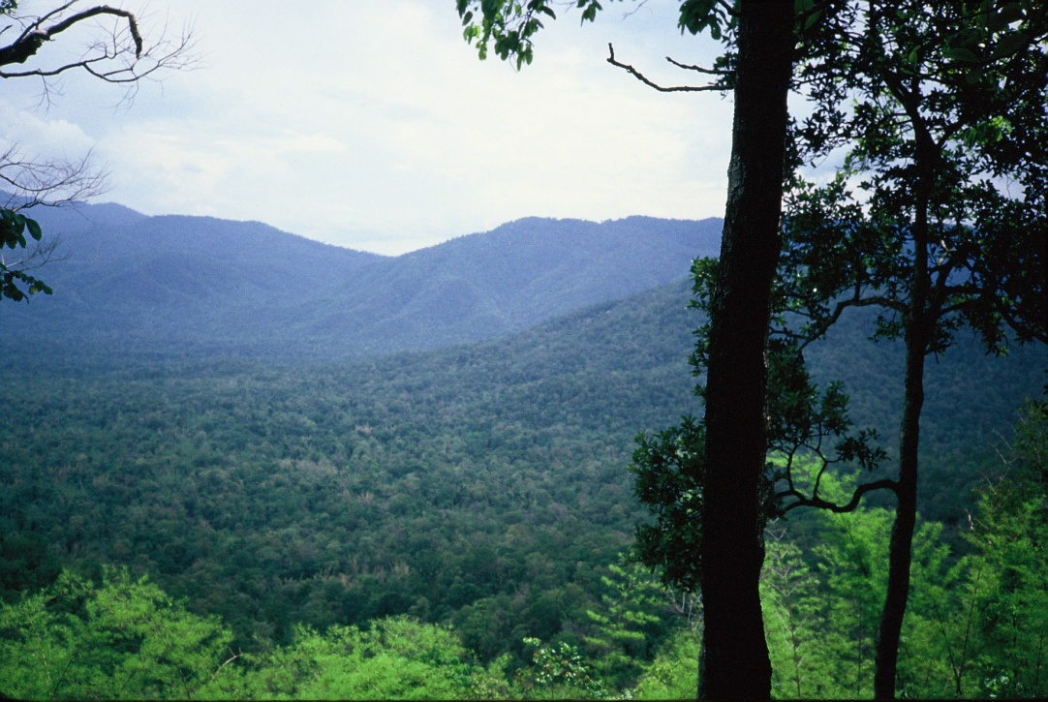
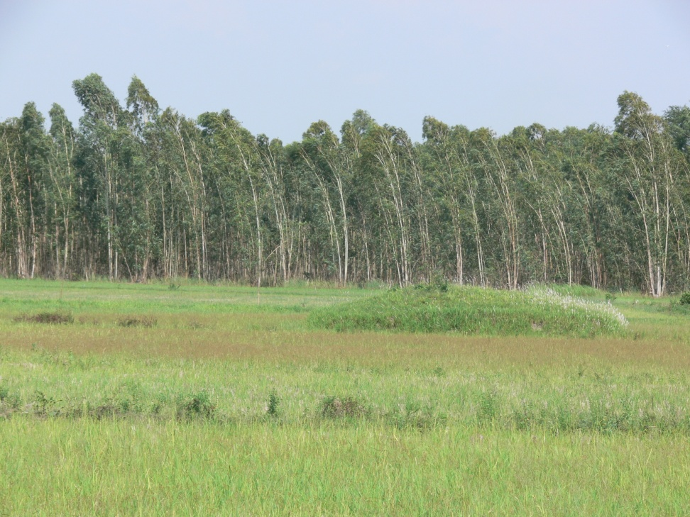
Forests then and now
1985
2010

Slide 4
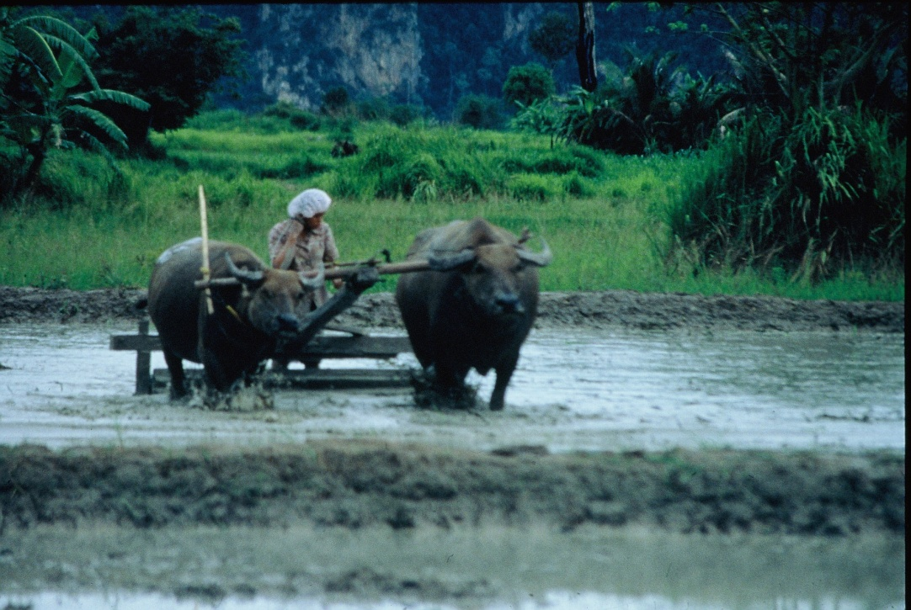
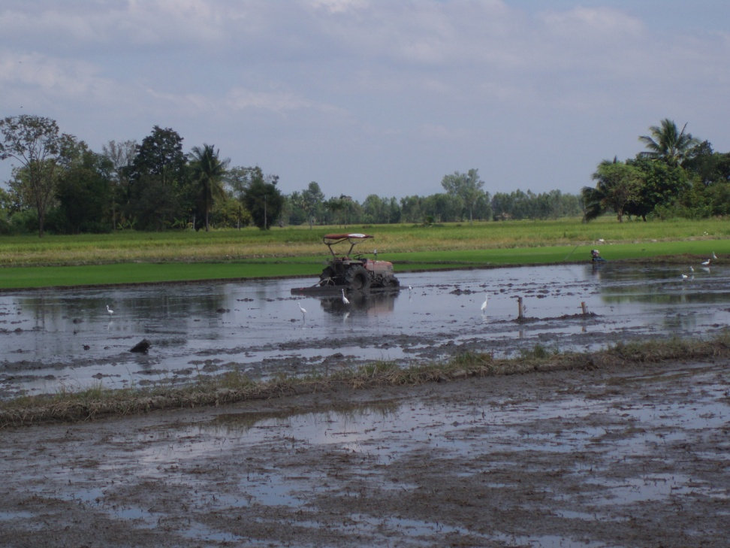
Harrowing then and now
1985
2010

Slide 5
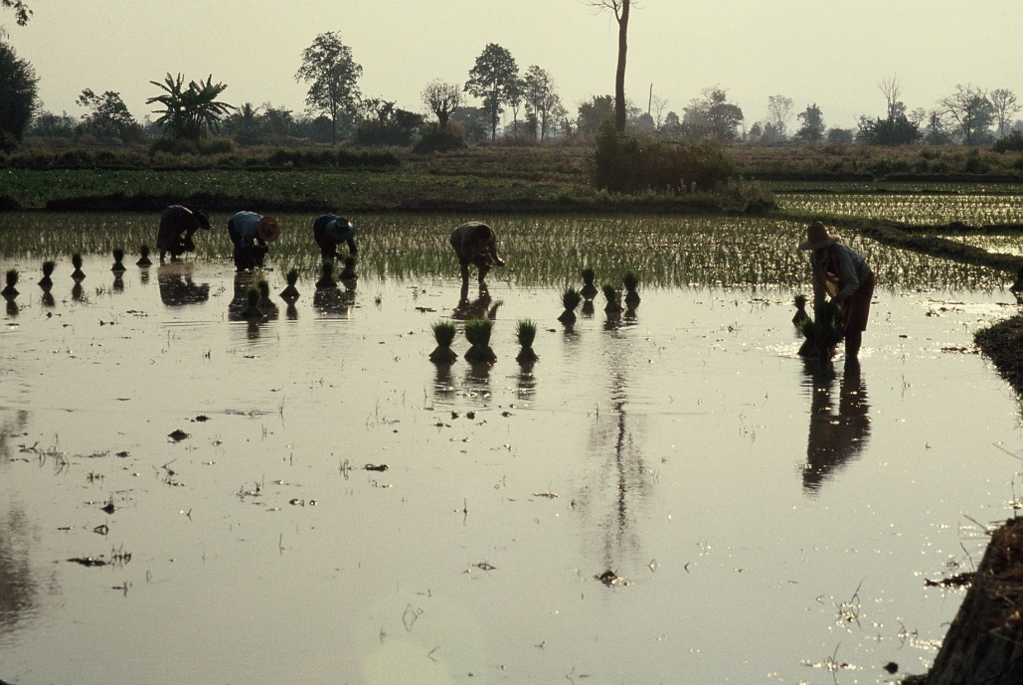
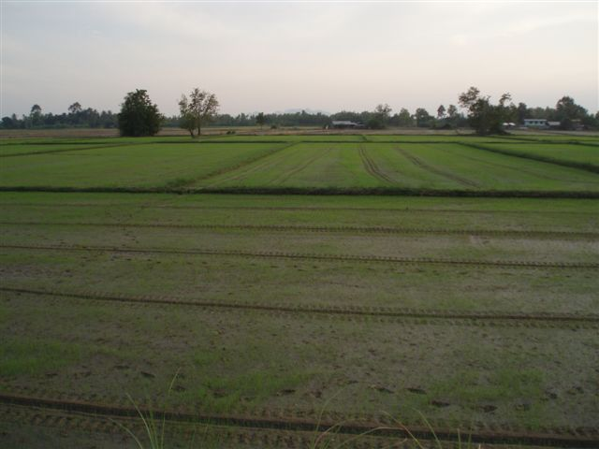
Planting then and now
1985
2010

Slide 6
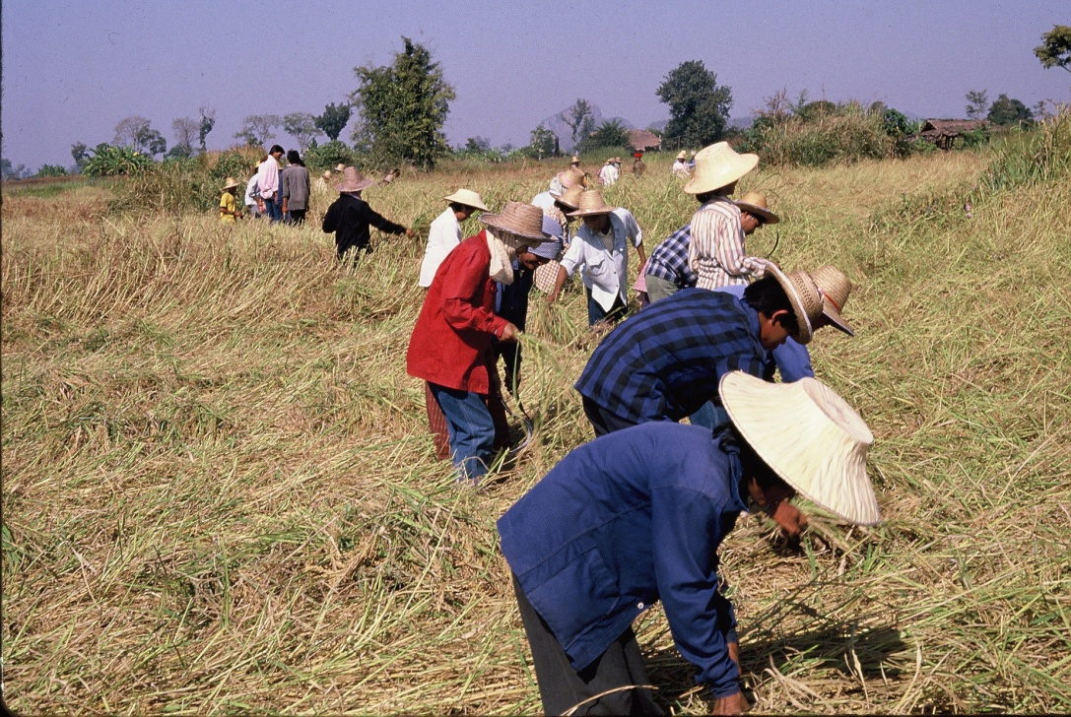
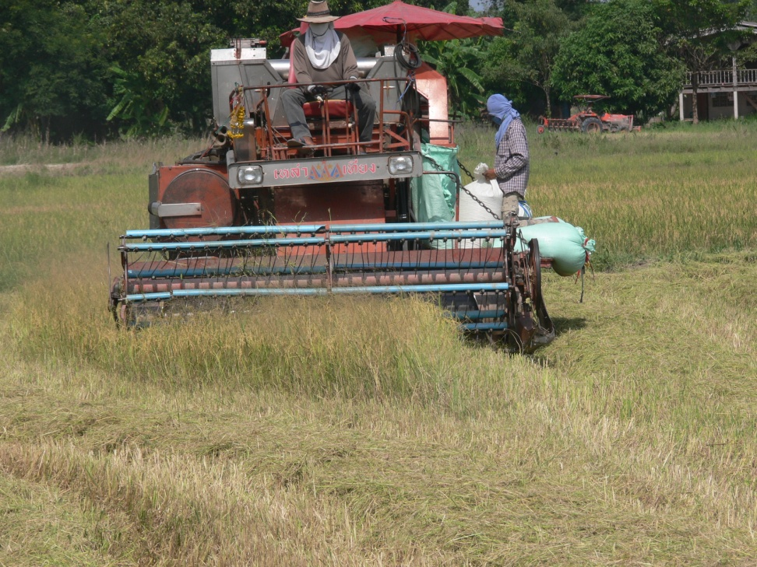
Harvesting then and now
1985
2010

Slide 7
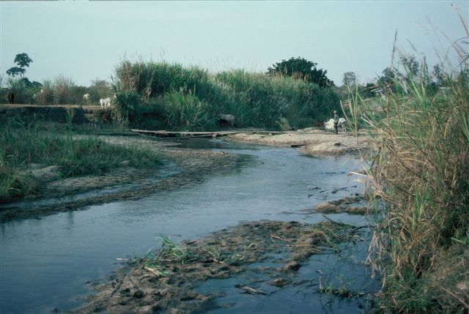
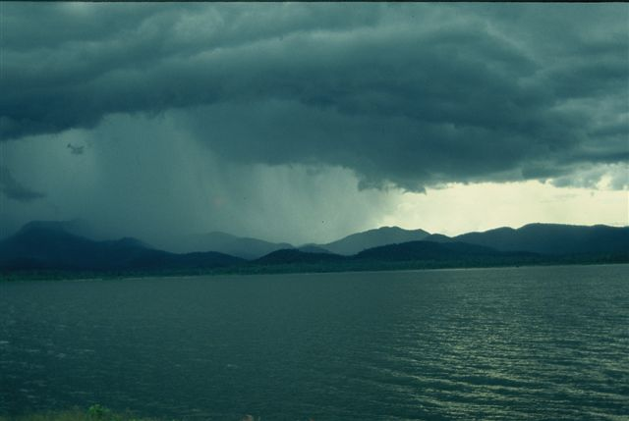
Tab Salao River then and now
1985
2010

Slide 8
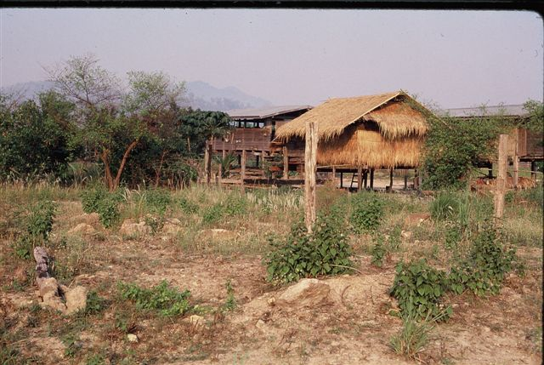
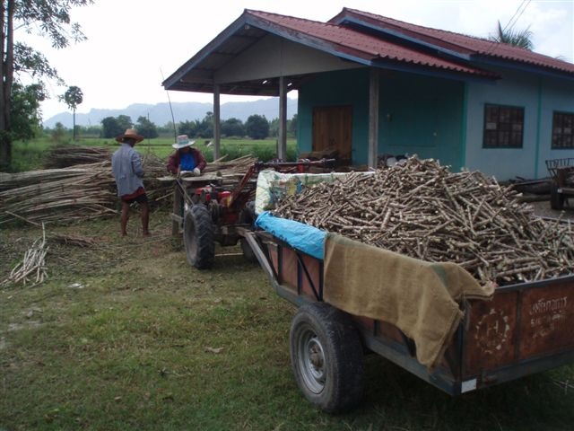
Small house then and now
1985
2010

Slide 9
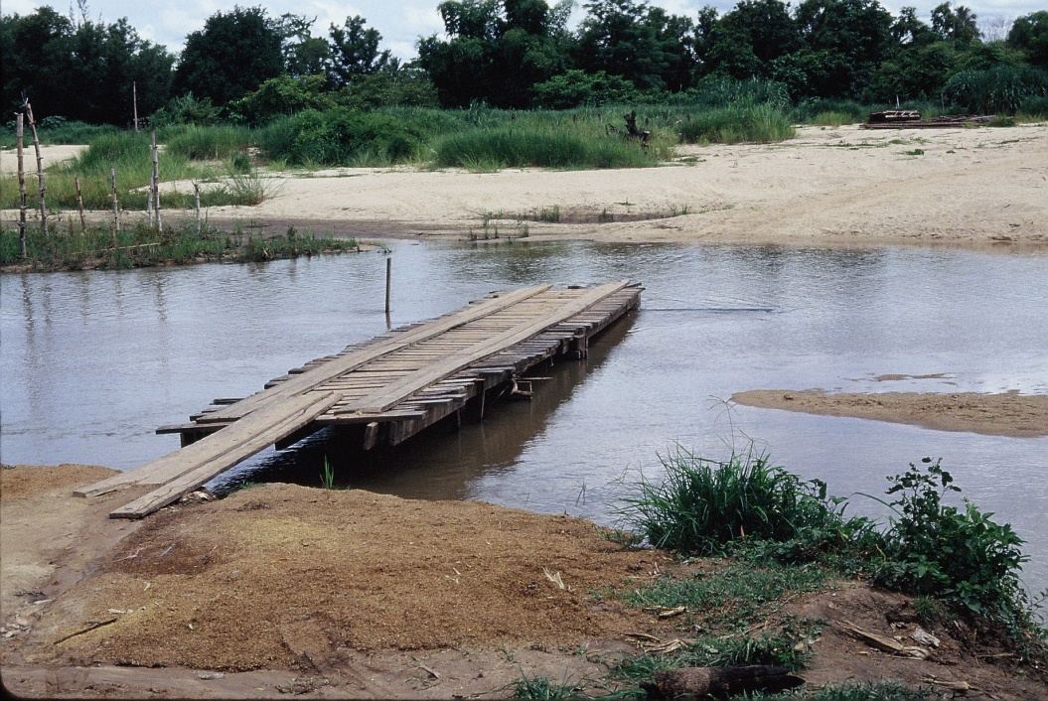
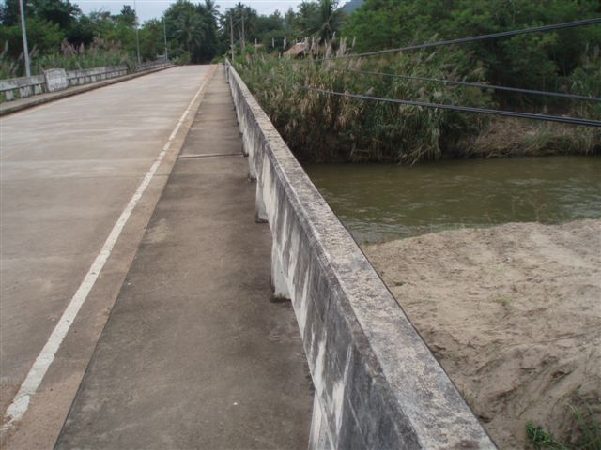
Infrastructure then and now
1985
2010

Slide 10
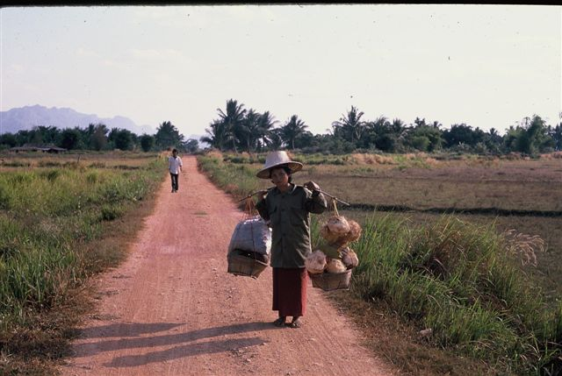
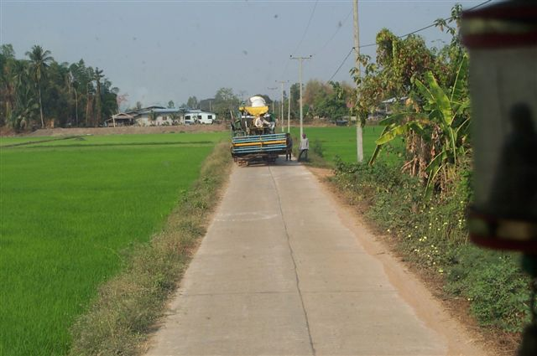
Road then and now
1985
2010

Slide 11
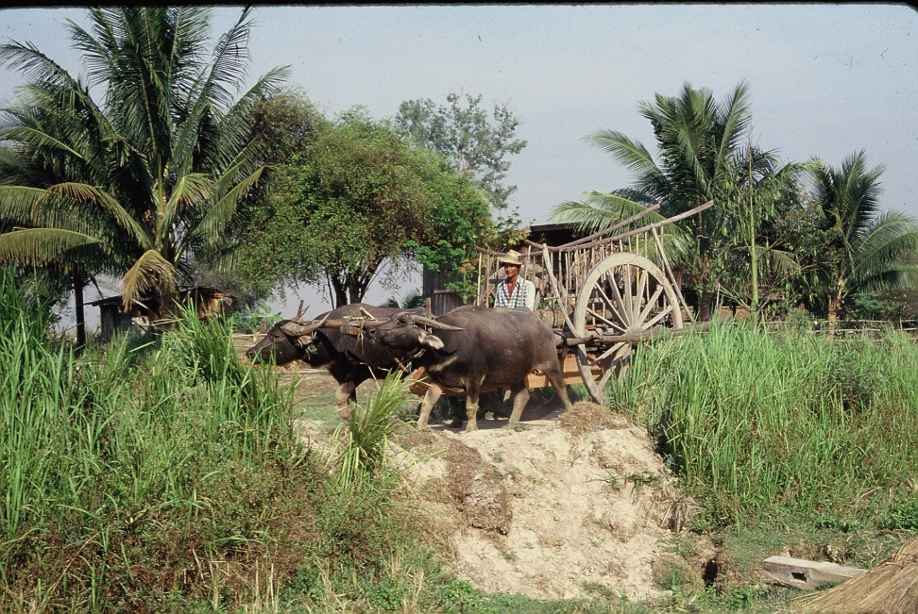
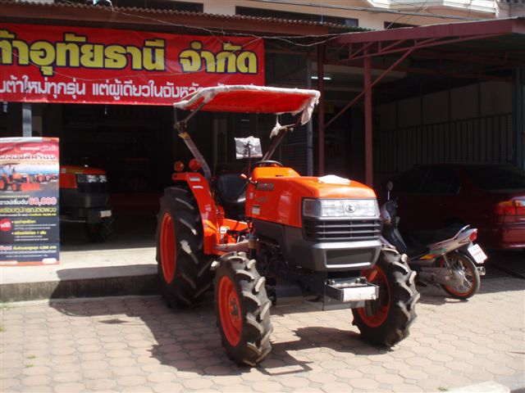
Transport then and now
1985
2010

Slide 12
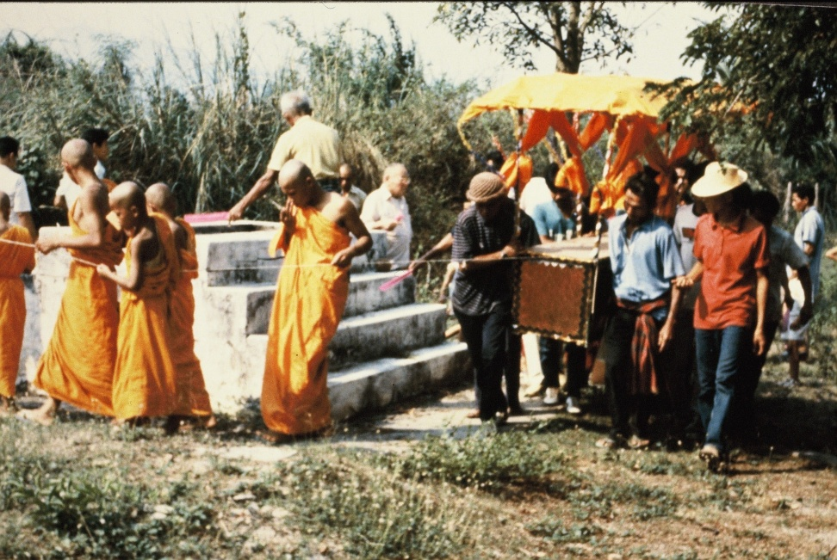
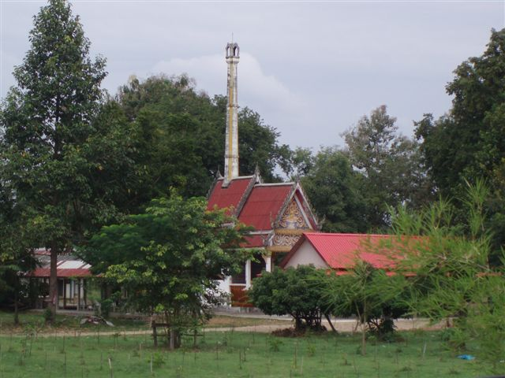
Cremation then and now
1985
2010

Slide 13
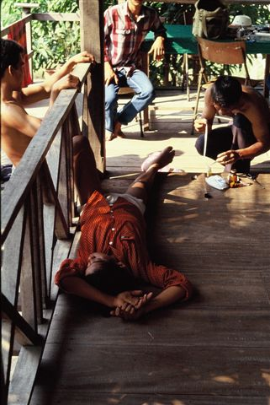
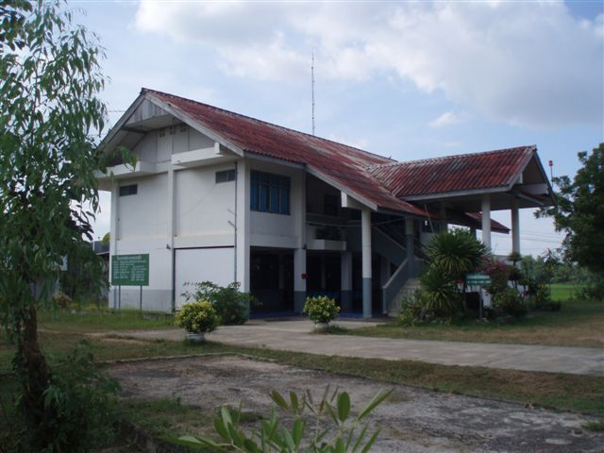
Health treatment then and now
1985
2010

Slide 14
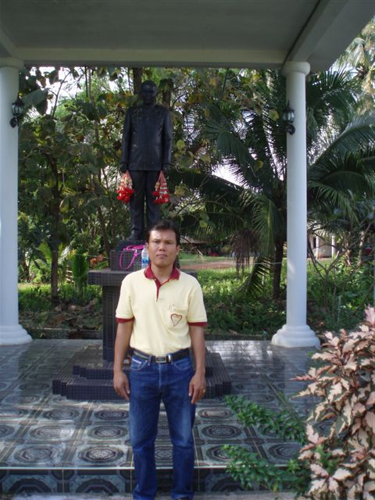
Leadership then and now

Slide 15
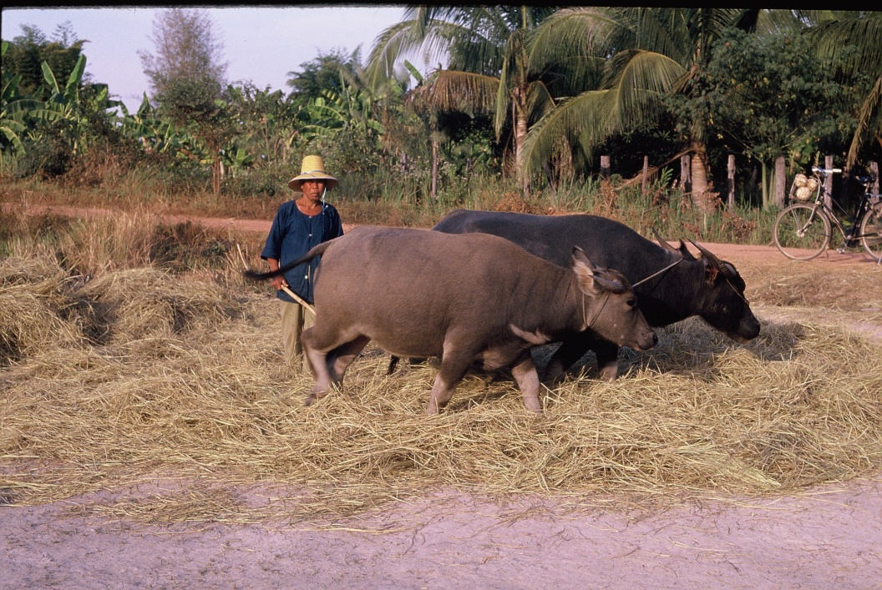
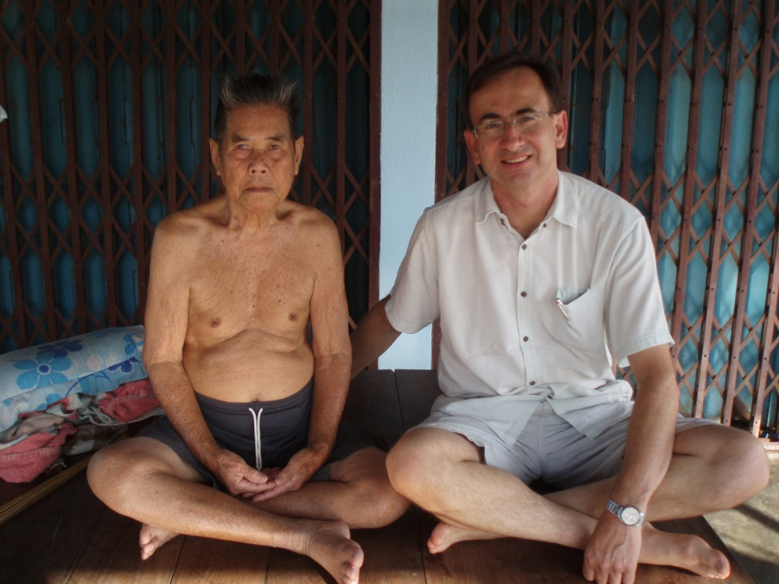
Catching up after 25 years
1985
2010

Slide 16
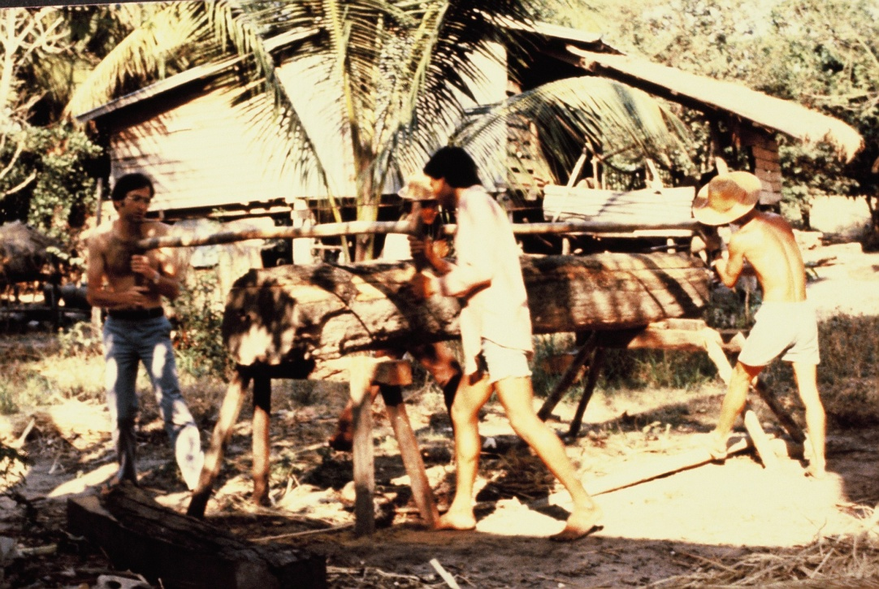
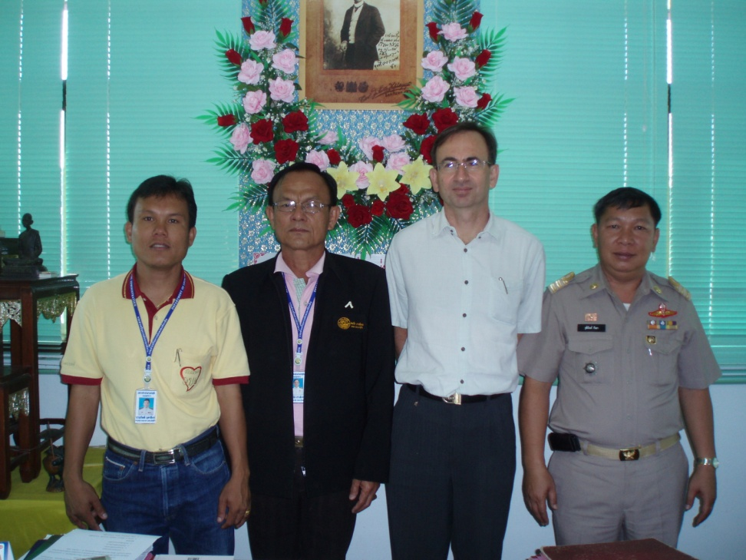
The researcher then and now
1985
2010

Slide 17
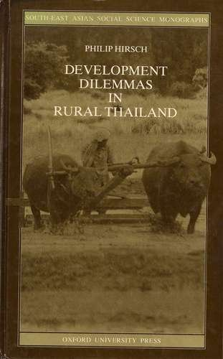
Interpreting change then and now
The original study….
The restudy
Conceptual lenses
Rural differentiation and inequality
Village and state
Environmental transformations
The story
The changed village context
Three families
Themes
Continuity and change
Surprises
Need for conceptual flexibility

