Slide 1
AN ANALYSIS OF LAWS IN THAILAND GOVERNING THE PRODUCTION OF ELECTRICITY USING WASTE PRODUCTS
Asst.Prof.Dr.Khettai Langkarpint

Slide 2
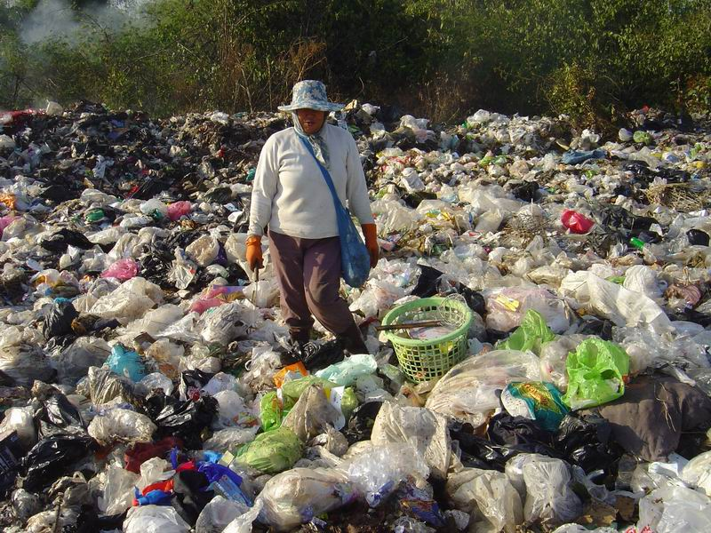
How many wastes a day..?
How can we mange them.....?.
Do we know waste-to-energy ?
Is Thailand ready for these ?...
How does the laws govern?........

Slide 3
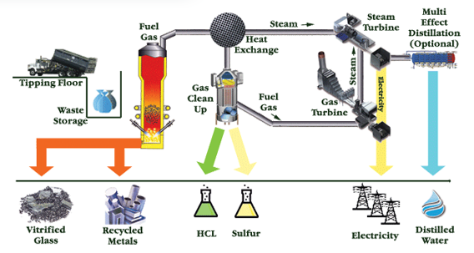
waste-to-energy
http://www.wastetoenergyplan.com/images/waste-to-energy_18.png

Slide 4
Objectives of the research
To study the classifications and definitions of wastes by laws and government units
To study the laws, standards and the ways to develop an environment which will encourage development and innovation in the power plant ;type waste-to-energy in Thailand
To compare the laws of Thailand with other countries.

Slide 5
The benefits of the research
To know the definitions and classification of what constitutes waste by laws as determined by each government units
To know the laws which governing the production of electricity using waste products (waste-to-energy)in Thailand to amend the laws in the future
To apply with the academic research and the development of law (waste-to-energy) in Thailand and foreign law

Slide 6
Hypothesis of the research
The laws which governing waste-to-energy in Thailand are not consistent, logical and unmanageable situation at present.

Slide 7
Scope of the research
To study the problems and the obstacles of the laws in Thailand governing the production of electricity using waste products.

Slide 8
Research methodology
A documentary research of waste to energy laws in Thailand comparing with the other countries

Slide 9
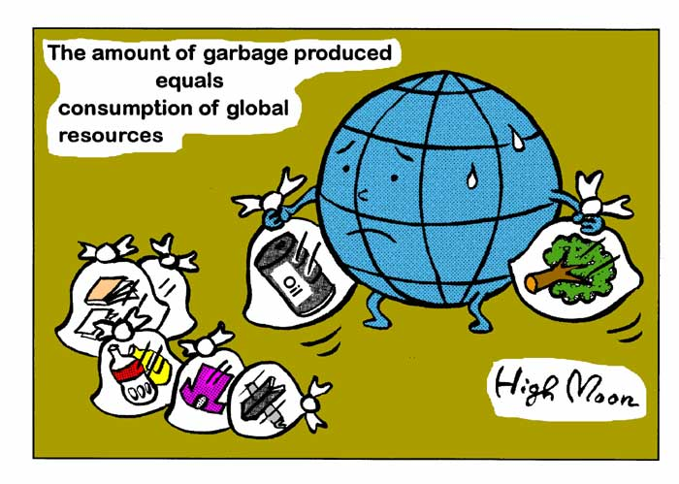
The definitions of waste by laws and governmental units
waste
refuse
sewage
garbage

Slide 10
The definitions by laws
The Enhancement and Conservation
of National Environmental Quality Act, B.E. 2535
The Public Health Act,2535
The Notification of Ministry of Industry, 2548
The Bangkok Regulations,
Bangkok Metropolitan Administration,2544
Waste
Refuse/
Garbage
Sewage/
unused able
material

Slide 11
The Enhancement and Conservation of National Environmental Quality Act, B.E. 2535, A.D. 1992
"Waste" means refuse, garbage, filth, dirt, wastewater, polluted air, polluting substances or any other hazardous substances which are discharged or originated from point sources of pollution, including residues, sediments or remainders of such matters, either in the state of solid, liquid or gas.

Slide 12
The Public Health Act, B:E. 2535 (1992)
"Sewage" means excrement or urine and including any other thing that is filthy or gives foul odor;
Notification of Ministry of Industry Re: Industrial Waste Disposal B.E 2548
“Waste” shall mean unusable materials or all types of wastes generated from industrial activity including wastes from raw material, wastes generated from production process, products that are deteriorated in quality, and effluent having hazardous constituents or hazardous characteristics.

Slide 13
The B.M.A. - ORDINANCE: DISPOSAL OF GARBAGE, REFUSE AND UNCLEAN THING B.E.1978
Under this Ordinance:
«Garbage» means waste from paper, cloth, food, merchandise, ash, animal droppings or carcasses, including things swept from streets, market places, animal stalls, or other places.
«Refuse» means excrement or urine and shall
include anything which is unclean and has foul
odor.

Slide 14
Different laws, Different standards
The Public Health Act, B:E. 2535 (1992)
In summary, sewage and solid waste management is the responsibility of local authority. Therefore, in case of waste management in Bangkok area, the waste management will be under the responsibility of BMA.

Slide 15
BMA has the authority to allow anyone to carry
out solid waste collection business on its behalf,
and also has the authority to prescribe any rules,
procedure, and conditions governing the waste
management in Bangkok area.
It should be noted that, with respect to the fee for collecting and hauling the waste, the local authority will have the right to charge service fee not exceeding the rate of service fee prescribed by the Ministerial Regulations (No.2,1993).

Slide 16
The Factory Act 1992 (Notification of Ministry of Industry Re: Industrial Waste Disposal B.E. 2548)
The Factory Act mainly controls and regulates the establishment
and the operation of factories inThailand by paying attention to
the impacts of factory to the environment.
Generally, factories are required under this Act to be kept
clean and free from garbage and refuse at all time.
The waste elimination plant, however, will be mainly controlled
by the Enhancement and Conservation of National Environmental
Quality Act B.E 2535

Slide 17
Conclusion
The management of waste, by law is divided into two distinct categories:
Local level waste-community waste
Industrial level waste-industrial waste
Different laws and standards are applied to each type of waste categories

Slide 18
The classification of waste
(by governmental units)
1.By The National Environment Board of Thailand (NEB);Ministry of Environments and Technology
1.1 Decompose Trash
1.2 Non-decompose Trash
1.3 Toxic Trash

Slide 19
The classification of waste (2)
2.Damrongrajanupab Institute, Office of the Permanent Secretary of Ministry of Interior;
2.1 Wet Trash
2.2 Dry Trash
2.3 Toxic Trash or hazardous waste

Slide 20
The classification of waste(3)
3.Bangkok Metropolitan Administration, Bangkok regulation, 2545;
3.1 General
3.2 Decompose
3.3 Recycle
3.4 Hazardous
3.5 Contaminated

Slide 21
Conclusion:
The definition of “waste” products, as defined by existing laws, differs from the definition recognized in academia and certain academic journals. The definition of “waste” appears to vary depending upon what a particular proposal requires.

Slide 22
2. Laws and standards which governing the production of electricity using waste products

Slide 23
2. Laws and standards
Laws; fundamental laws
The Public Health Act B.E. 2535
The Cleanliness and Tidiness of the Country Act B.E.2535
The Determining Plan and Process of Decentralization to Local Government Act B.E.2542
Notice of Ministry of Industry; Dispose the waste or nonuse able material B.E.2548

Slide 24
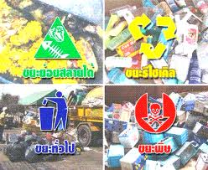

2. Laws and standards
Laws; (subsidiary laws)
Energy Conservation Promotion Act B.E.2535
Industrial Product Standard Act B.E.2535
Enhancement and Conservation of National Environmental Quality Act B.E. 2535

Slide 25
Conclusions
The management of waste, by law, is divided into two distinct categories: local level waste, or “community waste,” and industrial level waste, called “industrial waste.” Different laws and standards are applied to each type of waste categories.
To dispose the waste and using the products for the electricity power plant (waste-to-energy), there is no law. (the processing of waste)
There are only 2 fundamental laws governing ; the industrial product standard Act B.E.2535 and the energy conservation promotion Act B.E. 2535.
There is still no laws or regulations (subsidiary laws) to issue the product standard for the fuel in waste-to-energy.

Slide 26
The obstacles and legal problems to set up the power plant
The legal controls of disposing the waste are different. (community/industry waste)
The Joint venture Investment (the private sector and government) Act B.E.2535
The Planning Act B.E.2535
How to apply the adder cost( buying electricity prices)?? it is cheaper between industrial and community waste for the adder cost.

Slide 27
3.Comparing with other countries
1. Germany
2. USA
3. Singapore
4. Japan
5. Netherlands
6. France
7. Chinese Taipei
8. Brazil
9. Australia
In many countries, there appear to be laws which govern primarily “collection waste” and “the processing of waste.”

Slide 28
In Netherland, they allow using the production of electricity using waste products only the biogas. Because they are aware of using the toxic wastes, or other dangerous products.
In Germany, they use the recycle technology for the production but there are the collection waste law and the process of waste law to govern the waste-to energy.
In Thailand, it will depends on the areas to which technology will be suitable and there are not yet the laws of “collection waste” and “the processing of waste.”

Slide 29
4. The technologies and legal measures (waste-to-energy) to apply within Thailand

Slide 30
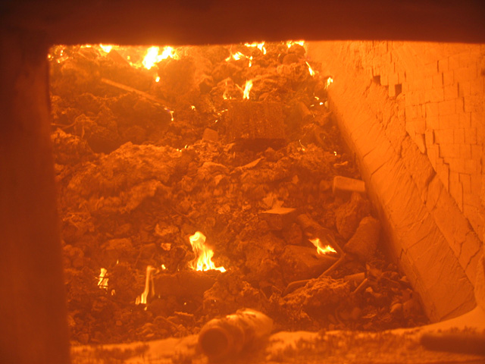
The technologies
1. Incineration-To burn the waste at 800 –1200°c then will have gas (heat energy) to produce steam or electricity and ashes to use for (material) flooring.

Slide 31
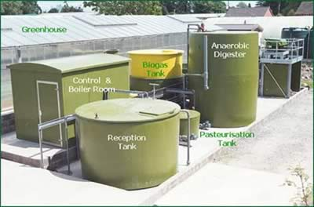
2. Anaerobic Digestion, AD- To dispose the organic waste that can be digested i.e. Food (the remains), vegetable, fruit. By bring it to fermentation in the tank. The organic waste will digested by microorganism and get biogas to use for fuel to produce the energy and the remains can be used for fertilizer.

Slide 32
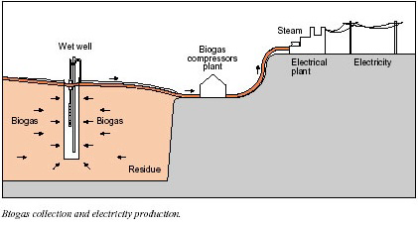
3. Landfill Gas to Energy- it is chemical decomposition of wastes in the tank. First, it is decomposition using oxygen then will be decomposition (no oxygen) and release the methane, carbon dioxide, hydrogen sulfide and nitrogen. The quantity of methane and carbon dioxide is more than other gas.

Slide 33
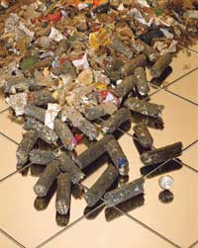
4. The Refuse Derived Fuel:RDF)- the RDF have a better heat and quality than the waste. There are mostly used in the cement industry to reduce the use of coal for their fuel.

Slide 34
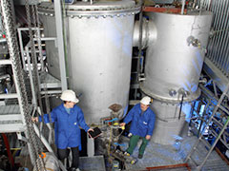
5.Gasification- to burn the waste in incinerator at the temperature 1,200-1,400 c and will get the gas fuel to produce the electricity.

Slide 35
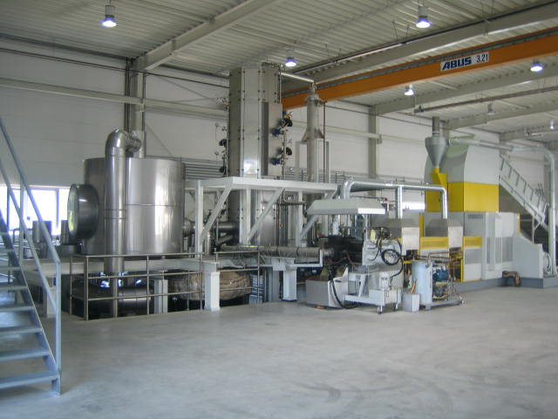
6.Depolymerization- to burn the waste (plastic) and will get fuel to use for electricity.

Slide 36
legal measures
Start from the laws or regulations which governing primarily “collection waste” and “the process of waste”( including the technologies) that is suitable in the area.
In case of community waste, the power plant should make contract with local government for minimum waste (tons per day) to produce electricity.
The adder cost should be the same price.

Slide 37
Conclusions and proposes
In Thailand, the fundamental laws are as the following:
(1) the collection waste law-Sec.20 of the Public Health Act B.E. 2535 executed the governor of Bangkok to issue the regulations of Bangkok (Reg. No.6) –not yet
(2) the reuse waste law-not yet announced
(3) the recycle waste law-not yet
(4) the process of waste-to-fuel law-not yet
The subsidiary laws ; to be amended
1.The industrial product standard Act B.E.2535
2.The energy conservation promotion Act B.E. 2535

Slide 38
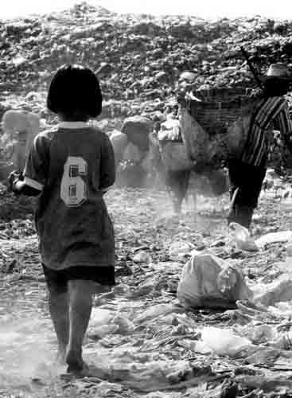
Thank you
Questions?

