Slide 1
The Time in Thailand
Narrative structure, time, and meaning in Apichatpong Weerasethakul’s ดอกฟ้าในมือมาร [“Mysterious Object at Noon” (2000)]
By William M. Owens, MA
MSLIS Candidate, Pratt Institute, New York City

Slide 2
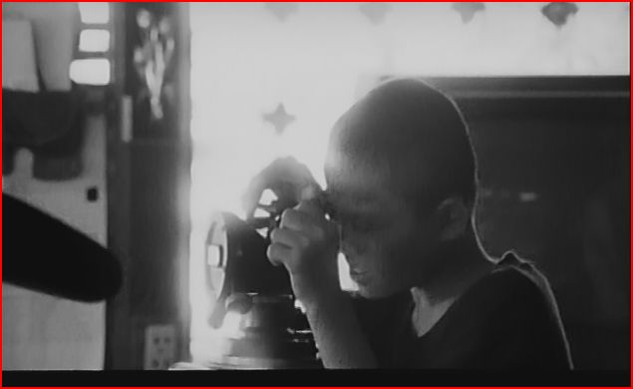
Introduction
Approaching Apichatpong

Slide 3
General Themes of essay
To situate art cinema in national context of Thai cinema and to challenge dominant theories concerning national cinema and the “national narrative”
To point out importance of new circuits of exchange and new forms of expression
To discuss expectations and audiences and the performative value of cinema production and consumption
To understand how changes are wrought within a “public sphere” in Thailand
To show how Apichatpong articulates visions of the future through atemporality

Slide 4
Temporality in Cinema
Mysterious Object as metaphor of movement, geographic and temporal
Time’s linearity and historical narrative as opposed to atemporal cinema and Surrealist collage
Time as a function of technology (specifically the technology of cinema)
Walter Benjamin’s “aparatus” and its function to engender “equilibrium”

Slide 5
The Exquisite Corpse
Surrealist parlor game, the rotating corpse, the exquisite cadaver
“Corpse” as symbol in Apichatpong’s work
Used here the exquisite corpse is not merely a cinematic gimmick but is intended to introduce Apichatpong’s syntactic and atemporal mode of producing a new narrative of alterity that counteracts dominant national narratives
Surrealist collage cannot be reduced to a cutting and pasting technique, a material practice of collating distant realities. It is also, and more essentially, a creative act of detournement, through the subversive manipulation and creative transformation of ready-made elements, forging the surreal out of fragments of the real, suggesting the merveilleux through the combination of banal and defunct images, clichés and rewritten texts. It is essentially a semiotic practice of transforming pre-formed ironic or verbal messages.
Elza Adamowicz

Slide 6
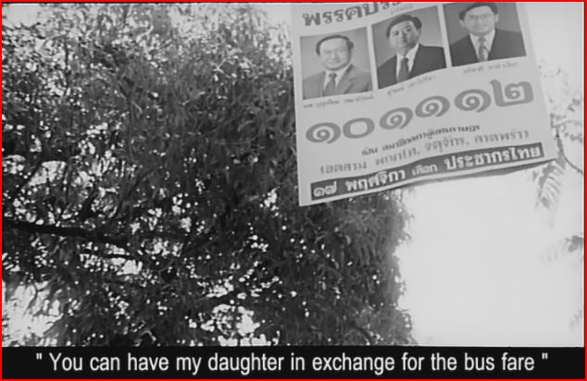
Still from Mysterious Object. A “defunct image” of a non-descript political campaign is de-contextualized during the fish-sauce woman’s story of being sold to a relative.

Slide 7
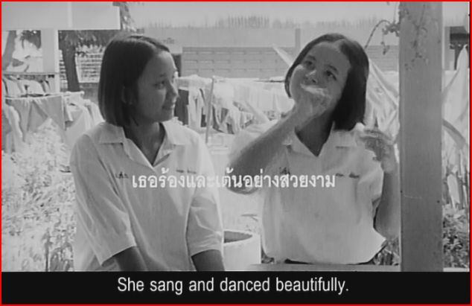
Meta-narrative, non-verbal storytelling

Slide 8
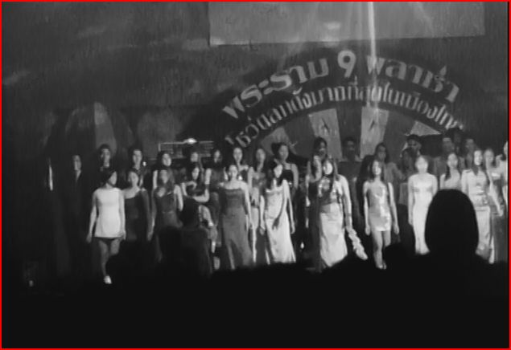
Urban Visions in Apichatpong’s work

Slide 9
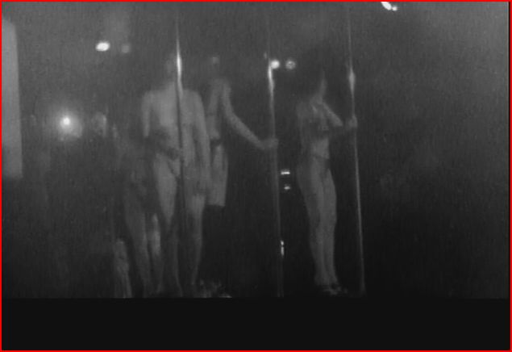
“She sang and danced beautifully.”

Slide 10
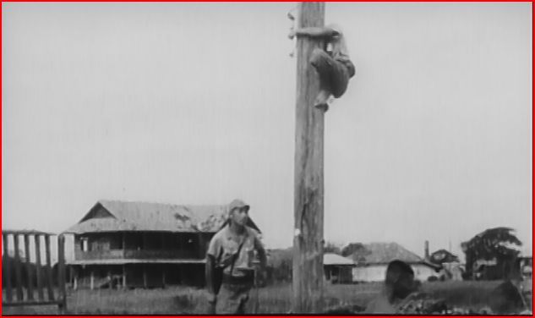
Conclusions and Observations

